Slide 1



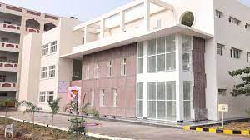
MALINENI LAKSHMAIAH
WOMEN’S ENGINEERING COLLEGE
Pulladigunta(V), Vatticherukuru(M), Guntur (Dist.)
Department of Computer Science & Engineering
CSE TODAY
Newsletter Sep 2022 Volume 9, Issue 2
Editorial Board Student Coordinators
Dr. JAppaRao, Principal, MLWEC MS.N.Lakshmi Priya,Iv B.Tech
Dr.G.RamaSwamy, HOD-CSE MS.P.Jwala Avigna,III B.Tech
MS.N.Bhavya,II B.Tech

Slide 2
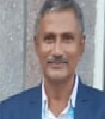
The Vision Of The Department
To emerge as the center of quality education in Computer Science and Engineering by
promoting competent and woman engineers with ethical values to serve the society.
The Mission Of The Department
MD1: To impart quality education through innovative teaching and learning methods.
MD2: To inculcate ethical and social values among the students for improving their life skills.
MD3 : To facilitate knowledge on updating technologies to meet industry requirements.
MD4 :To prepare students for software development, higher education, entrepreneurship,
and lifelong learning careers.
Principal Desk
It is a matter of great pride and satisfaction for Malineni Lakshmaiah Women’s Engineering College to bring out the News Letter ‘CSE TODAY’ Released from the Department of Computer Science and Engineering.
The College has made tremendous progress in all areas academic, non-academics, capacity building relevant to staff and students.
The College has achieved another milestone in getting NBA (National Board of Accreditation).And ISO 9001::2015
I am confident that this issue of Department News Letter will send a positive signal to the staff, students and the person who are interested in the Technical education and Technology based activities.
A News Letter is like a mirror which reflects the clear picture of all sorts of activities undertaken by a Department and develops writing skills among students in particular and teaching faculty in general.
I congratulate the Editorial Board of this News Letter who have played wonderful role in accomplishing the task in Record time.

Slide 3
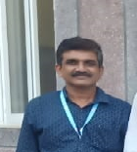
I express my deep sense of gratitude to Dr.G.RamaSwamy, HOD, CSE under whose guidance this Technical work has been undertaken and completed within the stipulated time.
Also my heartfelt Congratulations to staff members and Students for their fruitful effort. With Best Wishes
About The Department
Malineni Lakshmaiah Women’s Engineering College is one of the leading Engineering Colleges, helping students to realize their dreams and to become valuable assets to the nation. The Department is committed to academic excellence in the fields of Computer Science, leading to develop students through academia and industry linkages.
The Department of CSE started its journey of UG program B.Tech (CSE) in the year 2008 with an intake of 90 and PG program M.Tech (CSE) in the year 2012 initially with an intake of 24. At present the department has expanded to 360 students with 2 UG programs, B.Tech (CSE), and B.Tech CSE (Data Science). Currently the department runs PG program M.Tech (Artificial Intelligence) from the year 2022 with an intake of 12.
The intellectual ambiance in the Department of CSE is conducive for the holistic development of the students. The main idea of the department is to equip young minds with technical skills, along with ethical values, so that they can make a meaningful contribution towards the development of country in the field of Computer Science and Engineering.
The Department has a team of good experienced and motivated academicians whose expertise spans the range of disciplines in Computer Science stream. There is a healthy work-culture and the students are eager to coup with the changes and demands of the Industry and Society.
The Department goal is to provide students with a balance of intellectual and practical experiences that enable them to serve a variety of societal needs. In the department, students are nurtured to become best Software Professionals or Team Leaders in Industry or become Entrepreneurs in their own innovative way. Faculty also teach the students to work in teams, share their ideas, present, improve communication skills and join creative teams that make a positive difference.
On behalf of the administration, Computer Science Department welcomes the students and wish them bright journey of learning in the field of Computer Science.

Slide 4
Paper Publications
S.no | Name of the faculty | Title of the Paper | Name of the Journal | Volume,Issue no &page Number | ISSN Number | Date
1 | Dr.M.Bheemalingaiah | Advanced Cyber Crime Rate prediction using deep learning &AI Based Algorithm | Journal of Harbin institute of Technology | Vol-54, Issue no:3 | 0367-6234 | 30-03-2022
2 | Dr. A. SriRama Kanaka Ratnam | Advanced Cyber Crime Rate prediction using deep learning &AI Based Algorithm | Journal of Harbin institute of Technology | Vol-54, Issue no:3 | 0367-6234 | 30-03-2022
3 | Dr. G. Rama Swamy | A Study on Predication Of Diabetes Using Machine Learning | International Journal of Research | Vol-11 ,issue-6,Page No:286-297 | 2236-6124 | 26/06/2021
4. | Dr.M.Bheemalingaiah | Advanced Face Detection Using Machine learning & AI Based Algorithm | Journal of Harbin institute of Technology | Vol-54, Issue no:3 | 0367-6234 | 30-03-2022
5. | Dr. G. Rama Swamy | Advanced Face Detection Using Machine learning & AI Based Algorithm | Journal of Harbin institute of Technology | Vol-54, Issue no:3 | 0367-6234 | 30-03-2022
6 | Dr. G. Rama Swamy | Key Generation Using Genetic Algorithm for DNA Play Fair cryptosystem | Journal of Harbin institute of Technology | Volume-54,issue-9 pageNo:81-94 | 0367-6234 | 08-09-2022
7. | Dr. A. SriRama Kanaka Ratnam | Advanced Face Detection Using Machine learning & AI Based Algorithm | Journal of Harbin institute of Technology | Vol-54, Issue no:3 | 0367-6234 | 30-03-2022

Slide 5
Number of Collaborative activities for research, Faculty Exchange, Student exchange/Internship
S.no | Title of the collaborative activity | Name of the collaborating agency with contact details | Name of the participant | Year of collaboration | Duration
1 | Youth Employment Program | TCS Empowers | 12 | 2021 | 30 Days
2 | Digital Nurture | Cognizant | 6 | 2021 | 30 Days
Students/Faculty Who got NPTEL certificates
S.No | Name of the Student
1 | A. Satvika
2 | P. Anuhya
3 | J.Aswini
4 | B. Lakshmi Devi
5 | M .Devi Priyanka
6 | D.Naga Poojitha
7 | G.Keerthi
8 | P.Hema Latha
9 | Y.Kalyani
10 | K. Lakshmi Pravallika
11 | K.Mahitha
12 | M. Hari Priya
13 | M.Navya
14 | P.Mounika
15 | D.Mounika
16 | T.Naga Revathi
17 | A.Nanditha
18 | P.Sushmitha
19 | B.Pavani Lakshmi
20 | P.Hema Latha
21 | T.Bhavana
22 | P.Uma Devi
23 | N.Ch.JayaRao
24 | T.Sandhya Rani

Slide 6
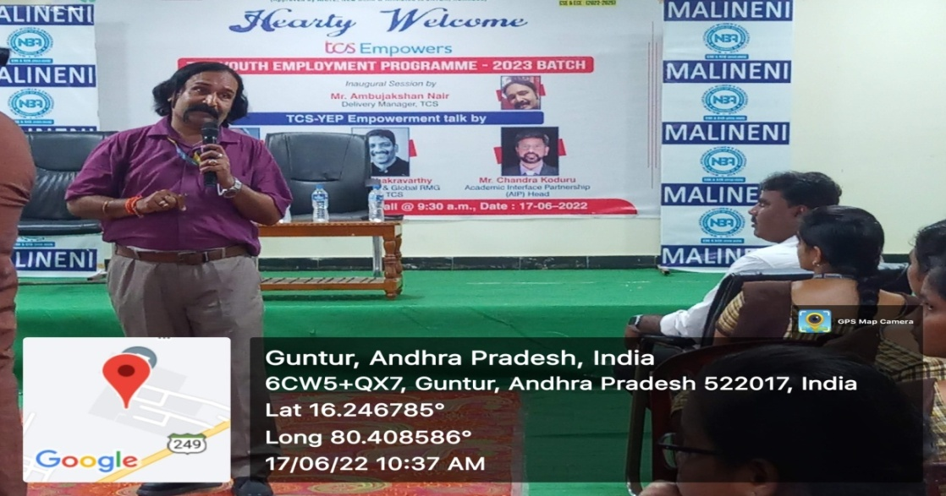
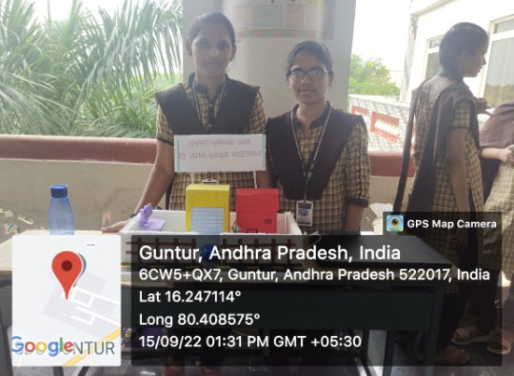
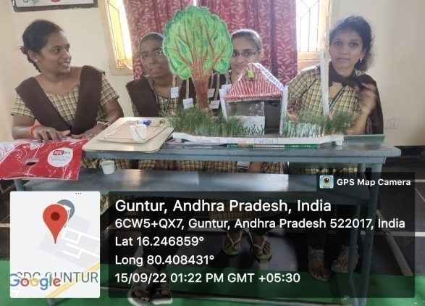
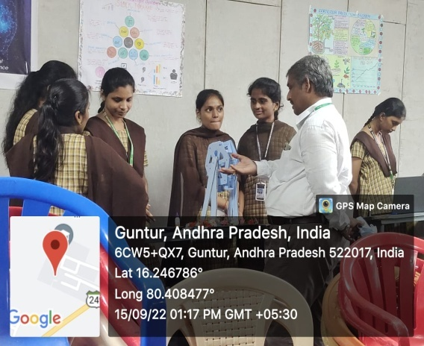
Tcs Youth Employment Programme Held By CSE Department
Department of CSE has Conducted Project Exhibition on IoT, AI, Black Chain Date:15/09/22

Slide 7
Toppers of the CSE Department
2-2(Semester)
S.No | Student Name | ID.No
1 | P. JWALA | 20KE1A0581
2 | CH. BINDU | 20KE1A0517
3 | K. AASHRITHA | 20KE1A0541
4 | Y. SIVA PARVATHI | 20KE1A05B3
3-2(Semester)
S.No | Student Name | ID.No
1 | B. SUPRIYA | 19KE1A0519
2 | A.NANDITHA | 19KE1A0510
3 | M. HARIPRIYA | 19KE1A0572
4 | M.NAVYA | 19KE1A0574
4-2(Semester)
S.No | Student Name | ID.No
1 | B. CHARISHMA CHOWDARY | 18KE1A0509
2 | K.NAGAMANI | 18KE1A0553

Slide 8
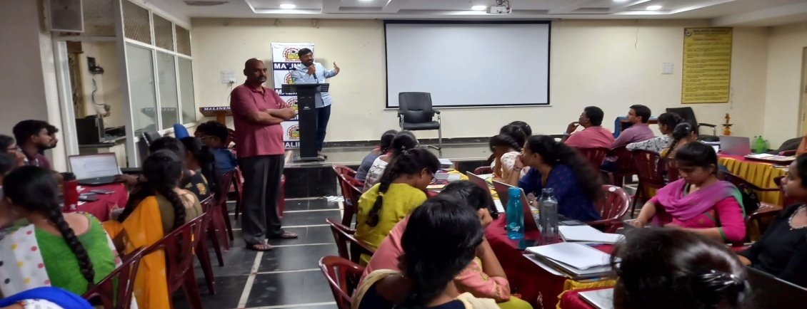
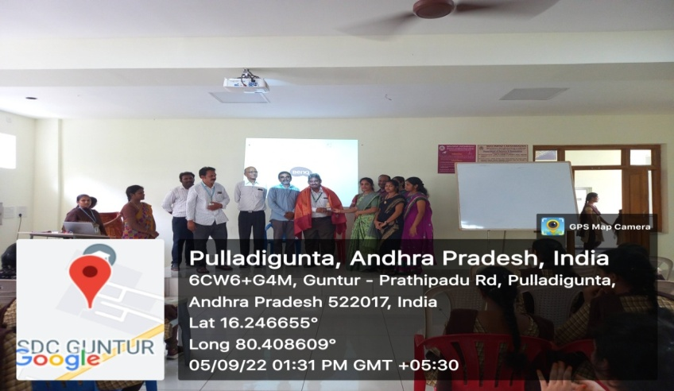
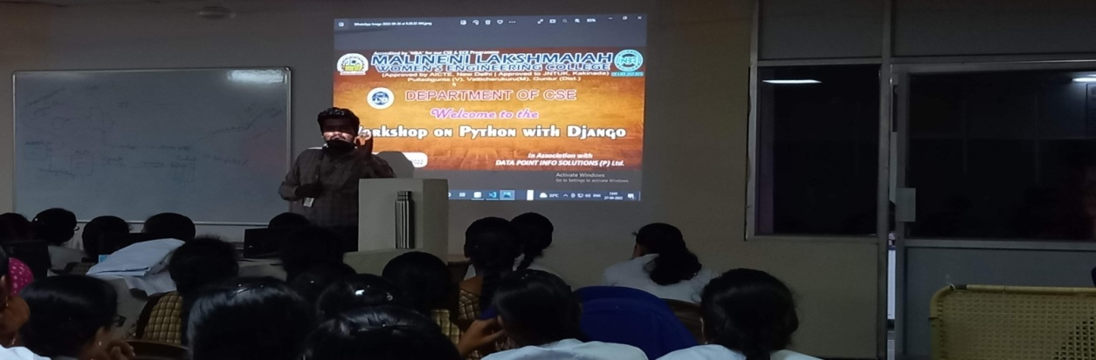
24 Hours Hackathon Program March 2022
Teachers Day Celebrations
Workshop on Python with Django

Slide 9
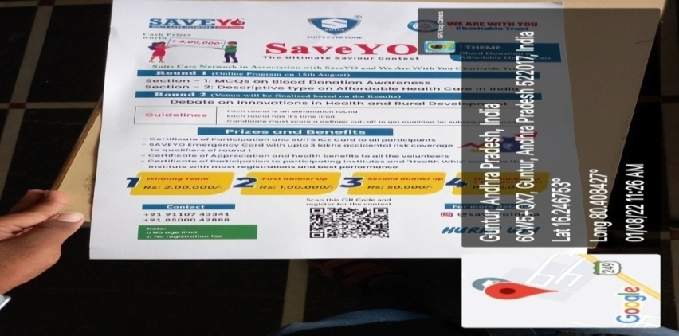
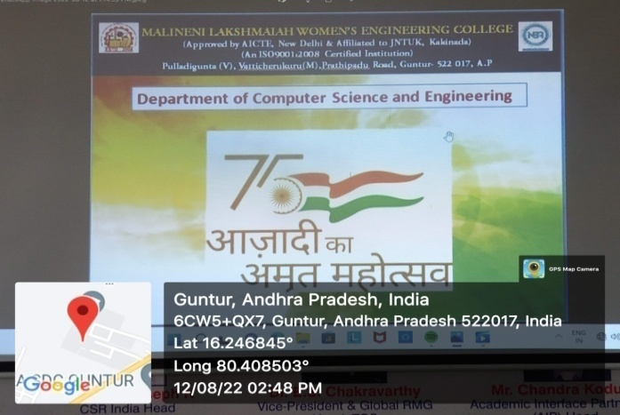
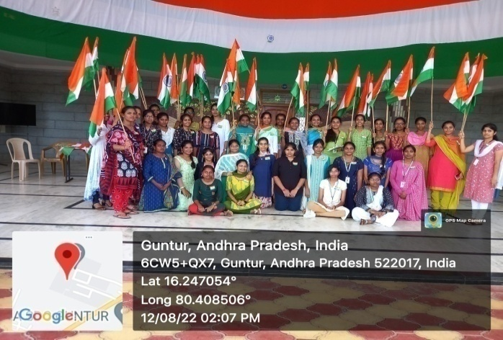
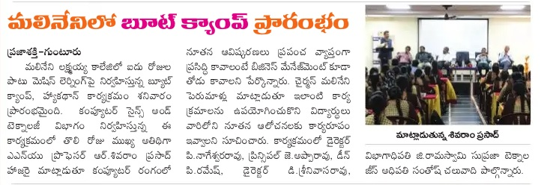
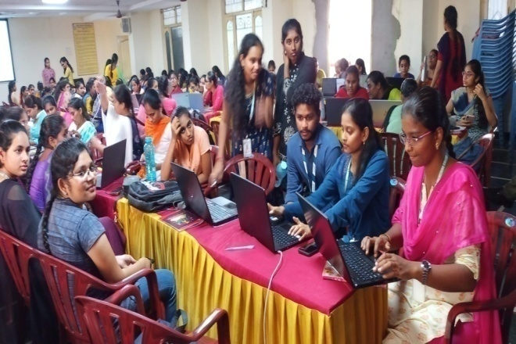
Blood Donation Awareness Program
Azadika Amrit Mahotsav
5 DaysBoot Camp Program conducted by CSE Department

Slide 10
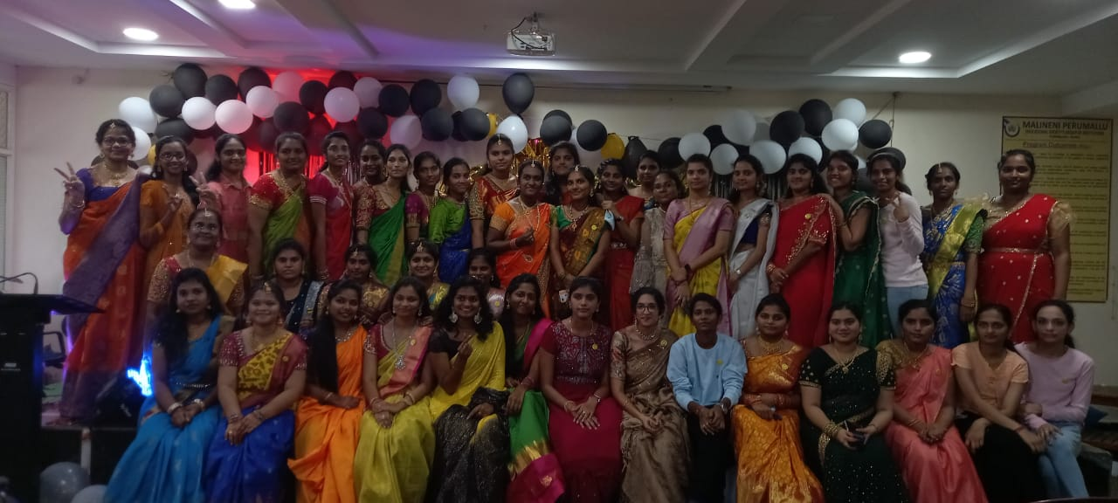

Farwell Day Celebrations
No of Students Placed in Campus Drive
STUDENTS
PROGRAM EDUCATIONAL OBJECTIVES (PEOs)
PEO 1 | Graduates will be able to utilize fundamental knowledge to meet the dynamic needs of Computer Science and Engineering problems.
PEO 2 | Graduates will be able to accomplish in the domain of programming skills learned in their curriculum to become successful engineers.
PEO 3 | Graduates will be able to provide feasible and socially acceptable solutions to real life problems in the areas of Computer Science and Engineering.
PEO 4 | Graduates will be able to acquire technical knowledge with leadership qualities, social awareness and ethical values with commitment.
PROGRAM SPECIFIC OUTCOMES (PSOS)
PSO 1 | Familiar with open-ended programming environments to develop software applications.
PSO 2 | Design and develop computer programs and computer-based systems in the areas related to Cloud Computing, AI and latest trending technologies.

Slide 11
FACULTY DETAILS
S.no | Name of the Faculty | Designation | Date of Joining
1 | Dr.P.NageswaraRao | Professor&Director | 04-07-2022
2 | Dr.G.Rama Swamy | Professor & HOD | 05-08-2016
3 | Dr.MatamBheemalingaiah | Professor | 17-07-2019
4 | Dr. A. SriramaKanakaratnam | Associate Professor | 05-06-2017
5 | Dr. N.Ch.Jaya Rao | Associate Professor | 02-06-2017
6 | Ms. MollaKhammar | Assistant Professor | 11-06-2017
7 | Ms. Y. Saraswathi | Assistant Professor | 11-06-2018
8 | Ms. I. Anusha | Assistant Professor | 03-06-2020
9 | Mr. A. Rajesh | Assistant Professor | 14-06-2017
10 | Ms. K.M.L.Priyanka | Assistant Professor | 12-06-2017
11 | Ms.V.Jhansi Lakshmi | Assistant Professor | 05/06/2015
12 | Ms.A .Aswini | Assistant Professor | 04-08-2020
13 | Mr.K.Sambi Reddy | Assistant Professor | 04-08-2020
14 | Ms.G. Vasantha Lakshmi | Assistant Professor | 11-06-2019
15 | Mr.P. VenuBabu | Assistant Professor | 15-10-2008
16 | Ms.N.Vijaya Lakshmi | Assistant Professor | 10-06-2020
17 | Mr.E.Prabhakar | Assistant Professor | 04-06-2022
18 | Mr.K.Praveen Kumar | Assistant Professor | 10-06-2010
19 | Mr.A.Rama Krishna | Assistant Professor | 29-06-2018
20 | M.Marry Lavanya | Assistant Professor | 03-06-2019
21 | Ms.P.Priyanka | Assistant Professor | 10-06-2022
22 | Ms.M.Sindhuja | Assistant Professor | 01-12-2014
23 | Ms.D.Vijaya Lakshmi | Assistant Professor | 11-04-2022
24 | Ms.K.Akhila | Assistant Professor | 07-06-2022
25 | Mr. A.Chandra Sekhar | Assistant Professor | 11-06-2018
26 | Ms.A.Nalini | Assistant Professor | 1-6-2022
27 | Ms.I.Aswani | Assistant Professor | 1-6-2022
28 | Ms.G.Srilakshmi | Assistant Professor | 4-08-2022
29 | Ms.Ch..Haritha | Assistant Professor | 4-08-2022

